Slide 1
CNL Customers CRD Summary Report
Prepared by:
SA Moy, Kevin Fong and Erjin Ren

Slide 2
Objectives
Share Findings from CMEE Mobile Industry Data Collection (Cannon Lake Platform Survey based on Skylake process)
    Summarize data collected from the Mobile Customers manufacturers:
      Compal Plant 4
      Compal Plant 2
      Compal Plant 3 (-Y, -U, -H)
      Inventec CQ (- Y and –U)
      MSFT/JDM1 (-Y, –U and -H)
      Pegatron
      Wistron KS
      Quanta SH and CQ
      CTE
          IP3
          Emdoor
          Weibu

Slide 3
SOLDER PASTE PRINT

Slide 4
Solder Paste Formulation ( Brand and Model)
Shenmao (PF606-P) | Senju | Yunnan Tin (YW9-3005-98CY04 ) | Others
Compal Plant 4 (Asus & Lenovo) | Compal Plant 4 (Senju M705-S101HF(NL3)-S4 | Compal Plant 2 (HP) | Pegatron Suzhou: YANKTAI (亞太微)
Inventec CQ | Pegatron Suzhou Plant 6 (Senju S101HF) | Compal Plant 3 (Dell) | CTE – IP3: Vitual LF4000A-6 (唯特偶)
MSFT (JDM1) | Wistron (Senju M705-S101ZH-S4(W2) |  | CTE – Emdoor: TongFang TF238_M305_D_885 (同方)
Pegatron CQ (Asus and Acer) |  |  | CTE – Weibu: N/A
Pegatron Suzhou
Pegatron Suzhou (Plant 6)
Quanta SH and CQ
Shenmao PF606-P is still preferred by many ODMs.
Compal is using Yunnan Tin across different plants.
Wistron still prefers to use Senju M705-S101ZH-S4(W2).
CTEs are using local brand solder pastes.
MSFT (JDM1) mentioned that in progress of evaluating solder paste listed in MAS
included Indium.

Slide 5
Stencil Thickness
3 mil (0.08mm): SKL-Y | 4 mil (0.10mm): SKL-U22 & -U23 & -H & -Y | 5 mil (0.13mm): SKL-H & -U
Compal Plant 4 | Compal Plant 4 | Compal Plant 4
Compal Plant 3 | Compal Plant 2 | Compal Plant 3
Inventec CQ | Inventec CQ | MSFT (JDM1)
Pegatron CQ | MSFT (JDM1)
Quanta SH | Pegatron CQ
Quanta CQ | Pegatron Suzhou Plant 6
CTE - Weibu | Wistron
 | Quanta CQ
 | Quanta SH
 | CTE – IP3
 | CTE - Weibu
Customers have 3 mil thick stencil capability included some of CTE customers.
Stencil thickness selection is based on package pitch and PCB pad size.
This is related to stencil Area Ratio.
MSFT (JDM1) prefers to use 4mil thick stencil with nano coating for SKL-Y.
This is to add more paste volume.
Compal and MSFT are using 5mil thick stencil for SKL-H package (0.65mm pitch).

Slide 6
Min. Stencil Aperture Opening per stencil thickness
With 3mil thick stencil, minimum aperture opening is 9mil.
Inventec changed to 0.245mm (9.65mil) to solve HoP issue on SKL-Y.
Customers feedback that 9mil stencil opening is challenging for paste release.
NOTE:
  Possible stencil technology different between U.S.A vs PRC stencil vendors.
  Working with Quanta and Wistron on fine pitch stencil technology
collaboration.

Slide 7
PNP

Slide 8
Min Ball Size Recognition Capability
0.18mm (7mil) | 0.2mm (8mil) | 0.254mm (10 mil)
Compal Plant4 | Compal Plant2 | Pegatron
 | Inventec | Quanta
 | MSFT (JDM1) | Wistron
 |  | Emdoor
 |  | Weibu
The answer is based on current process and not machine capability.
Mix information received.
Current SKL-Y solder ball size is 9mil (0.23mm) but customer’s
answer is 10mil (0.254mm).

Slide 9
Min Pitch Recognition Capability
0.30mm | 0.35mm | 0.40mm
Compal Plant 4 | MSFT (JDM1) | Compal Plant 2
CTE - Emdoor | Quanta | Inventec
CTE - Weibu |  | Pegatron
 |  | Wistron
The answer is based on current process and not machine capability.
Intel package smallest pitch is 0.40mm (SKL-Y), some customers have
experience with <0.40mm pitch BGA.

Slide 10
REFLOW

Slide 11
N2 Capability
Yes (O₂ppm) | No
Compal Plant 4 (<3000 ppm) | CTE – IP3 (machine is capable but factory does not have N2 facility)
Compal Plant 2 (<1500 ppm) | CTE – Emdoor (machine is capable but factory does not have N2 facility)
Compal Plant 3 (<40 000ppm)? | CTE – Weibu (machine is capable but factory does not have N2 facility)
Inventec (<1000 ppm)
MSFT (JDM1)
Pegatron SZ and CQ (<1000 ppm)
Wistron (<700 ppm)
Quanta SH and CQ (<3000 ppm)
CTE customers’ reflow machines are N2 capable but does not have
N2 facility in factory.
All major ODMs turn on N2.

Slide 12
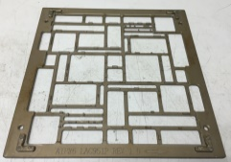
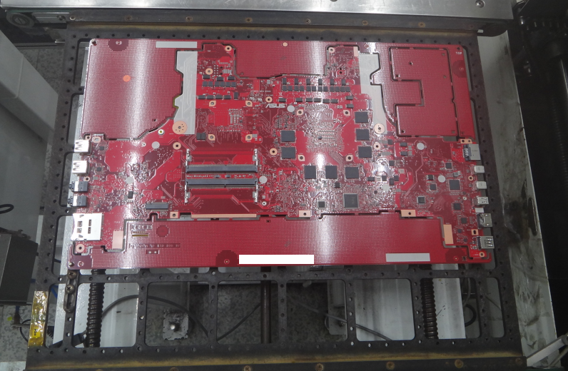
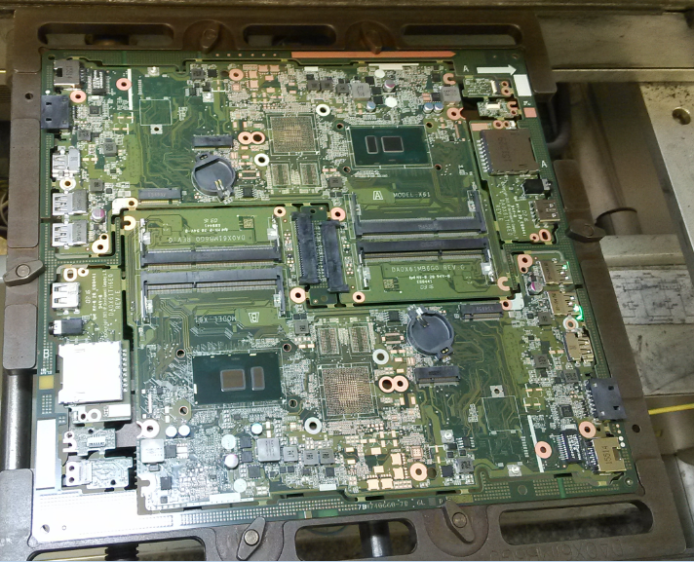
Reflow Pallet
Yes | Products Dependence
Compal Plant 4 | Pegatron SZ Plant 6 and CQ
Compal Plant 2 | CTE – Weibu
Compal Plant 3
Inventec
MSFT (JDM1)
Pegatron SZ
Wistron
Quanta SH and CQ
CTE – IP3
CTE - Emdoor
Compal Plant 4
Customers are using reflow pallet.
Normal practice:
  Universal pallet for secondary side
  Custom pallet for primary side
Wistron and Compal consider automation is part
of during reflow pallet design criteria.
Pegatron SZ – Universal pallet for secondary side
Quanta CQ

Slide 13
Rework

Slide 14
Rework Machine (Manual Hot Air Gun or Semi-Automated)
Semi-Auto | Manual Hot Air Gun
Compal Plant 4 | CTE - Weibu
Compal Plant 2 (Machine: Quick 2015)
Compal Plant 3 (Machine: Quick 2015)
Inventec
MSFT/JDM1 (SRT 1800)
Pegatron SZ and CQ
Wistron
Quanta SH and CQ
CTE – IP3
CTE - Emdoor
Besides CTE – Weibu prefers to use manual hot air, all other customers are
using semi-auto rework machine for Big Core packages.

Slide 15
Rework Process ( Flux Only, Paste Print etc. )
Customer | Flux / Paste | Paste on BGA / Board? | Flux on PCB
Compal Plant 4 | Both depend on package size | Board | AIM NC254
Compal Plant 2 | Paste | Board | Yunnan Tin: YW9-3005-98CY04
Compal Plant 3 | Flux | Both | AIM NC254
Inventec | Flux | - | Shenmao SMF-2
MSFT (JDM1) | Paste | Board | -
Pegatron | Paste | Board | -
Wistron | Both | BGA | Shenmao SMF-2
Quanta | Paste | Board | -
CTE – IP3 | Both
CTE – Emdoor | Flux |  | yc_m105_d_885
CTE - Weibu | Paste | BGA
ODMs did some process change to meet rework yield target.
Manual paste printing process on PCB is still very challenging for ODMs,
required skillful rework operators.

Slide 16
Yield Target

Slide 17
Customer | SMT | Rework | Remark
Compal Plant 4 | 1000 DPM | SKL U a. Under fill: 90% b. No Under fill: 95% SKL-Y a. Under fill: 85% b. No Underfill: 90% | OEM is Lenovo and requested to put under fill. Facing challenge in rework process. Request: Is Intel able to influence on Lenovo under fill decision?
Compal Plant 2 |  | 98%
Compal Plant 3 | 99% | 90% | SMT 1st pass yield for overall board.
Inventec | 99.5% | 90% | SMT 1st pass yield for overall board
MSFT (JDM1) | 500 DPM (99.95%) | 95% | For BGA part.
Pegatron | 500 DPM (99.95%) | 95%
Wistron | 99% | 95% | SMT: Overall board AOI yield target.
Quanta CQ | 99.50% | 80%
CTE – IP3 | 98% | 70% | SMT: Overall board yield target
CTE – Emdoor | 98.6% | 99% | SMT: Overall board yield target
CTE - Weibu | 98.5% | 90%
Expectation from customer is high to reach good SMT and Rework quality.

